Slide 1
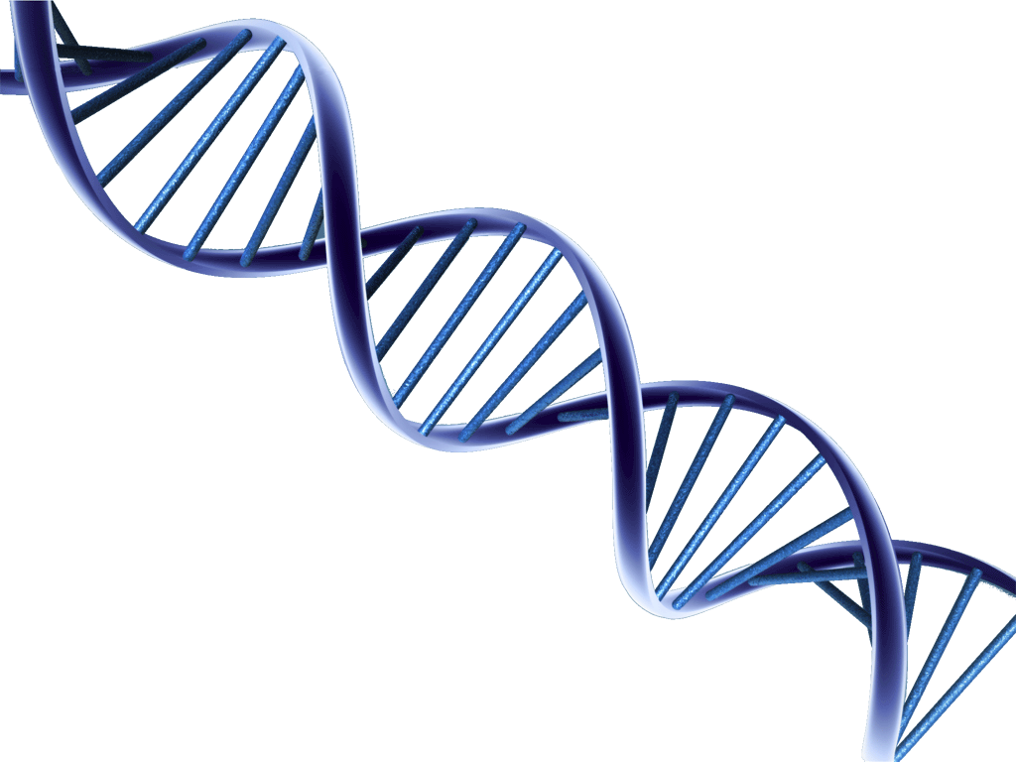
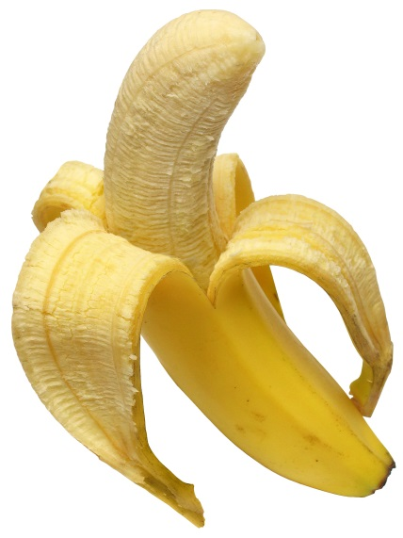
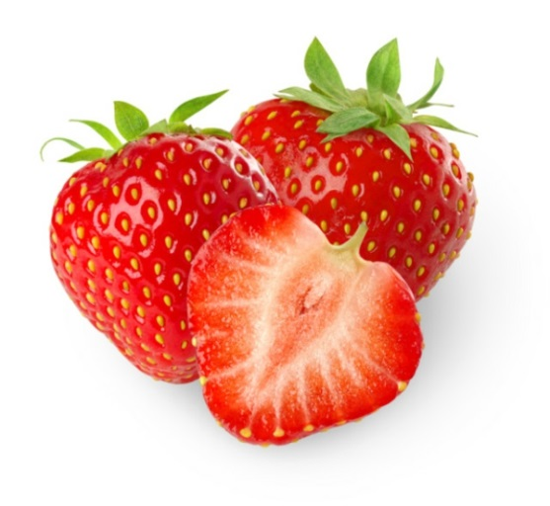
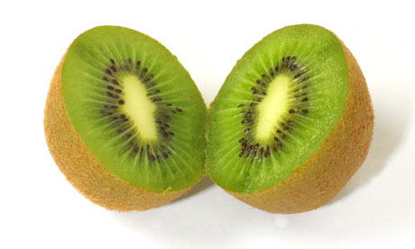

Slide 2
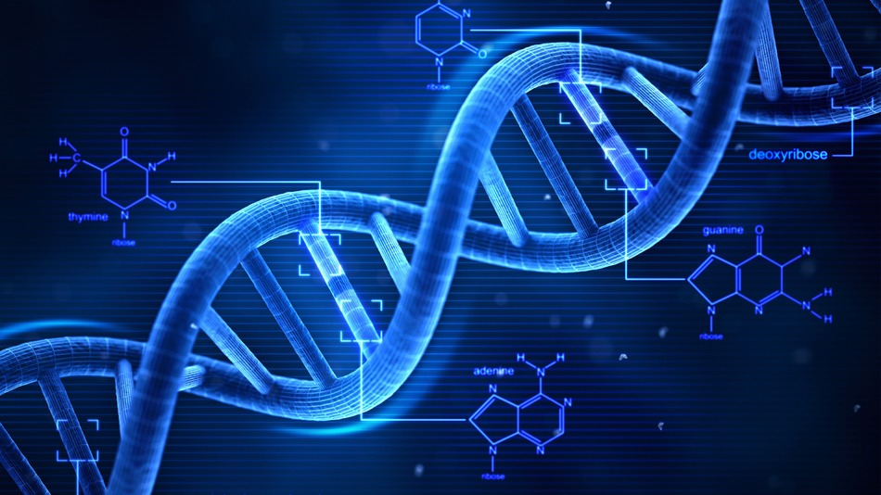
Purpose of DNA Extraction
To obtain DNA in a relatively purified form which can be used for further investigations, i.e. PCR, sequencing, etc……

Slide 3
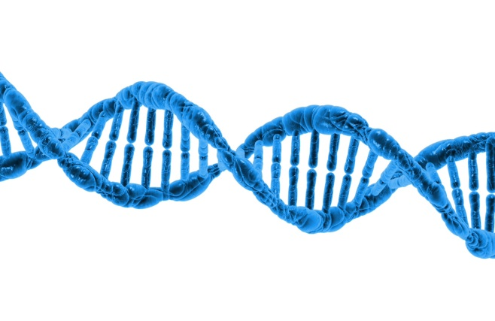
Simple DNA extraction
Alkaline cell lysis to break open the cells and organelles
Alcohol/ethanol precipitation: DNA remaining in the aqueous layer is concentrated by ethanol precipitation.

Slide 4
A comparison of DNA extraction methods used in research labs as opposed to classroom labs
Research
Lysis: Tissue grinder and use detergent
Precipitation Part I: phenol/chloroform extraction to get rid of proteins
Precipitation Part II: addition of salts to interrupt hydrogen bonding between water and phosphates on the DNA
Precipitation Part III: addition of ethanol to pull DNA out of solution
Wash and resuspend: DNA is washed in ethanol, dried (remove salts and other water soluble impurities ), and resuspended in H20 or TE buffer for long-term storage and stability
Classroom
Lysis: grind in mortar/pestel and use detergent
Precipitation Part I: NONE (chemical are too dangerous!)
Precipitation Part II: addition of salts to interrupt hydrogen bonding between water and phosphates on the DNA
Precipitation Part III: addition of ethanol to pull DNA out of solution

Slide 5
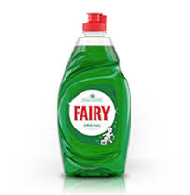
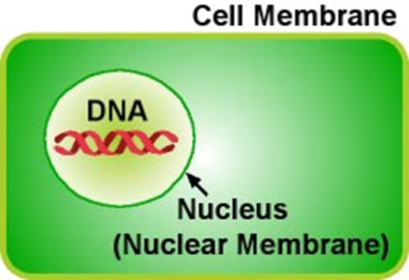
LYSIS: In DNA extraction (from plants), this step commonly refers to the breaking of the cell wall and cellular membranes (most importantly, the plasma and nuclear membranes)
The cell wall (made of cellulose) is disrupted by mechanical force (for example, grinding the leaves)
Then the addition of a detergent in the which breaks down the cell membranes
Detergents are able to disrupt membranes due to the amphipathic (having both hydrophilic and hydrophobic regions) nature of both cellular membranes and detergent molecules. The detergent molecules are able to pull apart the membranes
The end result of LYSIS is that the contents of the plant cells are distributed in solution.

Slide 6
The cell and nuclear membranes have been broken apart, as well as all of the organelle membranes, such as those around the mitochondria. So what is left?
Proteins
Carbohydrates (sugars)
DNA
Cell debris – cellular membranes.

Slide 7
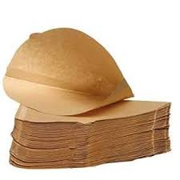
Filtration
Why?
To obtain DNA from cell debris
Cell debris – too large to go through the filter paper
DNA, protein, lipids and carbohydrates – small enough to go through the filter paper into the filtrate

Slide 8
PRECIPITATION (In a research lab): This a series of steps where DNA is separated from the rest of the cellular components
In a research lab, the first part of precipitation uses phenol/chloroform to remove the proteins from the DNA
Phenol denatures proteins and dissolves denatured proteins.
Chloroform is also a protein denaturant
THIS STEP CANNOT BE PERFORMED IN CLASSROOM LABS!!
The second part of research lab DNA precipitation is the addition of salts
The salts interrupt the hydrogen bonds between the water and DNA molecules.
The DNA is then precipitated from the protein in a subsequent step with isopropanol or ethanol
In the presence of cations, ethanol induces a structural change in DNA molecules that causes them to aggregate and precipitate out of solution.
The DNA is pelleted by spinning with a centrifuge and the supernatant removed

Slide 9
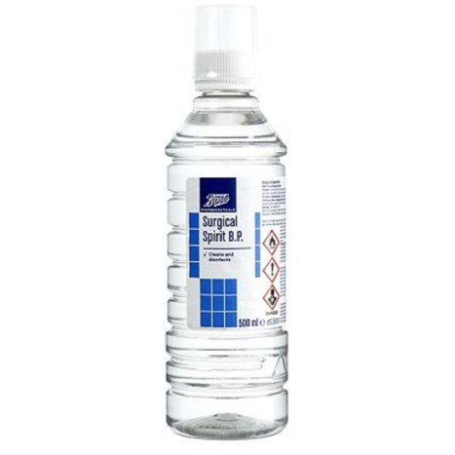
PRECIPITATION (In a classroom lab): This a series of steps where DNA is separated from the rest of the cellular components
In a classroom lab, DNA precipitation involves the addition of salts
The salts interrupt the hydrogen bonds between the water and DNA molecules.
The DNA is then precipitated from the protein in a subsequent step with isopropanol or ethanol
In the presence of cations, ethanol induces a structural change in DNA molecules that causes them to aggregate and precipitate out of solution.
DNA extracted in a classroom lab is not as “clean” as the DNA extracted in a research lab!

Slide 10
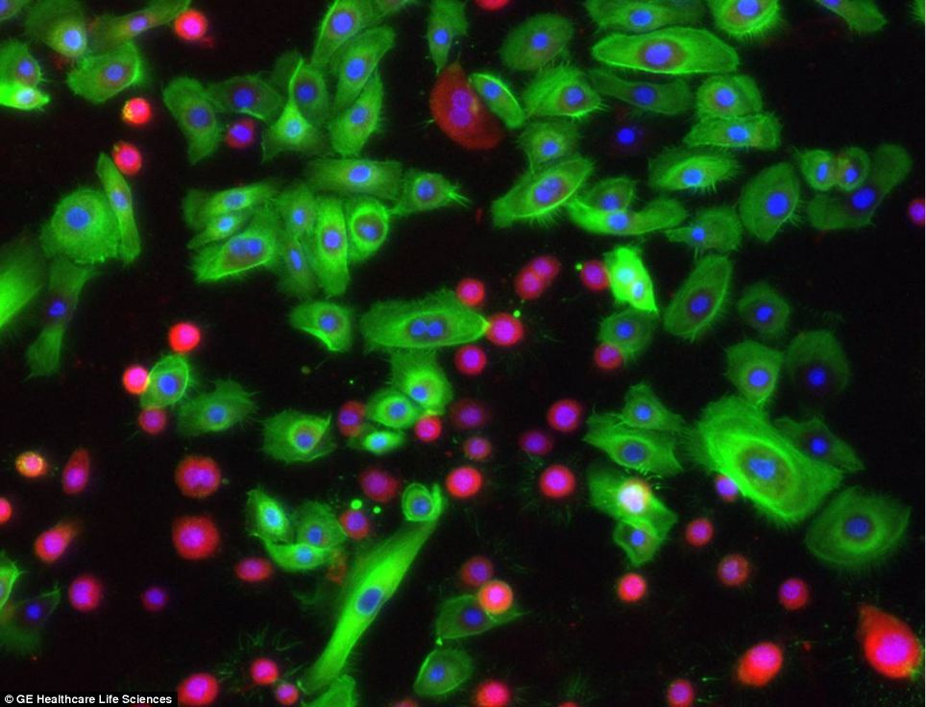
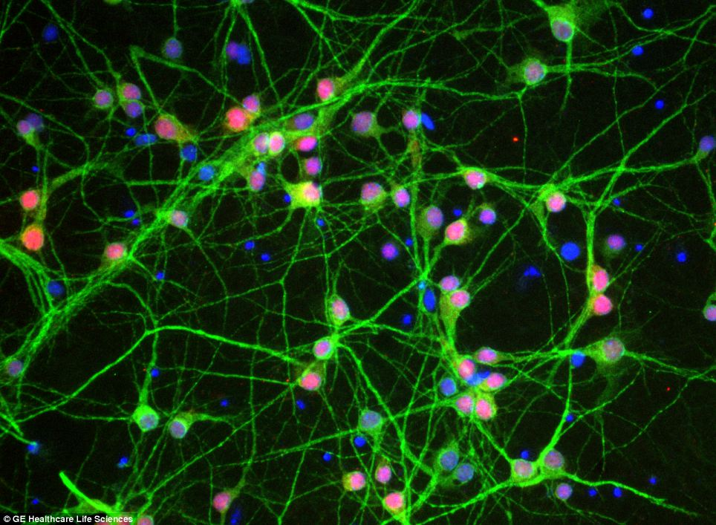
Human bronchial epithelial cells.
DNA is stained blue = DAPI
Cells are stained green or red = 488 and 594 Alexa Fluor
Pictured here are neurons in the brain of a mouse. Cells like these could help understand how conditions develop in illnesses such as Alzheimer's

Slide 11
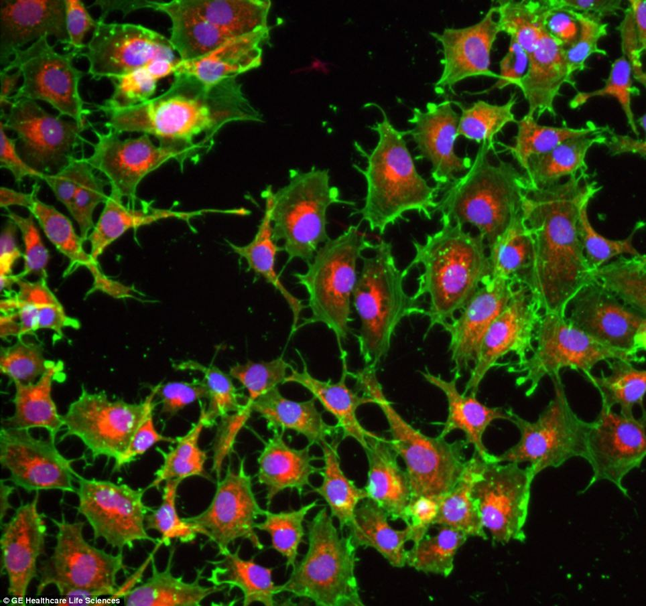
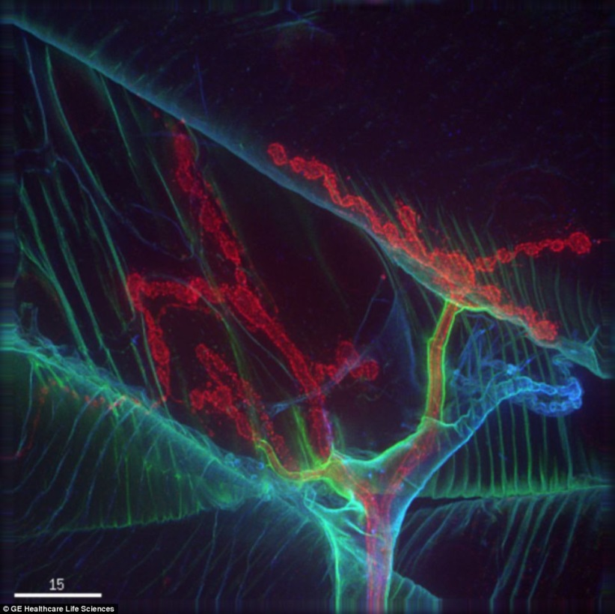
Pictured here are lung cancer.
Image of Drosophila (fruit fly) neuromuscular system
http://www.proteinatlas.org/

