Slide 1
Reach Cambridge
Teachers’ Workshop 2017
Teaching Routine
Changes from 2016
Guidance & Tips

Slide 2
Reach Cambridge 2017 – programs overview
Program 1:
EXPLORER
2nd July – 22nd July
(3 weeks)
Program 2:
LEADER
24th July – 6th August
(2 weeks)
Program 3:
SCHOLAR
7th August – 20th August
(2 weeks)
Typical Weekday
Time | Activity
Breakfast in College
9am | Subject Classes
1pm | Lunch – Free time
2.30pm | Afternoon Activities
Dinner in College
7pm | Evening Lectures
8pm | Evening Activities
Evening Curfew
Typical Weekday
Time | Activity
Breakfast in College
9am | Subject Classes
12.30pm | Lunch – Free time
2.30pm | Afternoon Activities or Leadership workshop
Dinner in College
7pm | Evening Lectures
8pm | Evening Activities
Evening Curfew
Typical Weekday
Time | Activity
Breakfast in College
9am | Subject Classes
12pm | Lunch – Free time
2pm | Subject classes (until 4.30pm)
Dinner in College
7pm | Evening Lectures
8pm | Evening Activities
Evening Curfew
Notes:
Don’t worry about copious notes – will send slides, and you’ll receive a handbook. Main thing to note down is good discussion points!
Shout out at any time if you have questions.

Slide 3
Reach Cambridge 2017 – programs overview
Notes:
Don’t worry about copious notes – will send slides, and you’ll receive a handbook. Main thing to note down is good discussion points!
Shout out at any time if you have questions.

Slide 4
Reach Cambridge 2017 – session timings & breaks
Session | Timing | Scheduled Break(s)
Explorer Class | 9am-1pm | 10-10.15, 11.45-12
Leader Class | 9am – 12.30pm | 10.30-10.45
Scholar AM Class | 9am-12pm | 10.30-10.45
Scholar PM Class | 2-4.30pm | 3.15-3.30
Registers must be taken at the start of each session.
A Reach staff member will come round in the first 15 mins to check all students are present, and a Reach staff member will come to the class later with notices.
Please also note that we have teachers’ lunch meetings on Monday afternoons.
Notes:
Don’t worry about copious notes – will send slides, and you’ll receive a handbook. Main thing to note down is good discussion points!
Shout out at any time if you have questions.

Slide 5
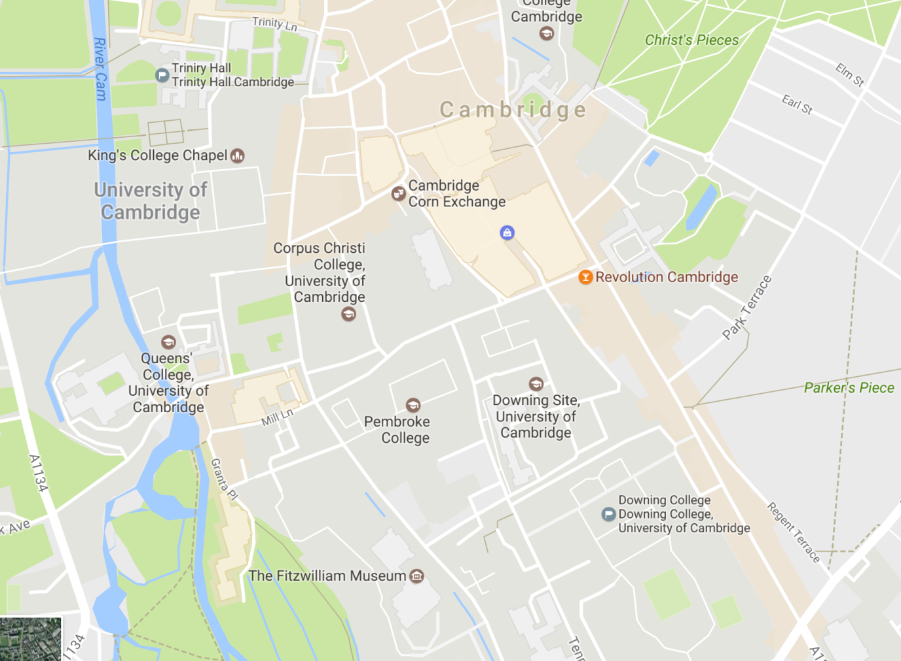
Reach Cambridge 2017 – classrooms and offices
Notes:
Don’t worry about copious notes – will send slides, and you’ll receive a handbook. Main thing to note down is good discussion points!
Shout out at any time if you have questions.

Slide 6
Reach Cambridge 2017 – classrooms and offices
Each classroom will have a projector & screen and a flipchart/whiteboard. Anything additional needs to be requested (on your session plan or in an email to Monika).
In both Trinity Hall and Downing we will have a Reach Office, in which you can find:
Stationery
Some spare equipment (e.g. Laptops, speakers)
Reach staff members
All experiments will need to be planned in advance and contain a risk asessment.
Notes:
Don’t worry about copious notes – will send slides, and you’ll receive a handbook. Main thing to note down is good discussion points!
Shout out at any time if you have questions.

Slide 7
Reach Cambridge 2017 – important contacts
Name | Role | Contact for
[Various] | Subject Course Coordinator | Subject-specific enquiries, e.g. Ask to change session topic
Monika | Director of Curriculum | Equipment queries, teaching advice, student issues
Scott | Program Dean | Student issues, esp. discipline
David | Programme Co-Director | Student issues, esp. discipline
Jenny | Programme Director | Student issues, esp. discipline
Precious | Programme Co-Director | Student issues, esp. discipline
Notes:
Available DURING SESSIONS – can be text/called, often in offices
Also – Jess, supervisors

Slide 8
Reach Cambridge 2017 – admin details
Registers will be on Google spreadsheets.
Subject webpages – in part to cut down on printing/photocopying, each subject will have a dedicated webpage. Monika will upload resources for you.
Observations – by DoC or coordinators.
Pre-reading – can be put on the website or emailed directly to students
Reach Teachers Database – coordinators will collect materials
Dress code – casual (but reasonable)
Supervisors - available for activities, trips, demonstrations, etc.
Class budgets – ask your coordinator or Monika
Notes:
Available DURING SESSIONS – can be text/called, often in offices
Also – Jess, supervisors

Slide 9
Reach Cambridge 2017 – How to plan your lessons?
Gauge initial level
Vertical alignment
Differentiation
Preparation
Extra material
Equipment/bookings/props
Notes:
Available DURING SESSIONS – can be text/called, often in offices
Also – Jess, supervisors

Slide 10
Part 1: Course planning and preparation
Activities
Excursions
Experiments
Guest speakers (also on different career perspective)
Topics
Vertical alignment
Level – initial test of knowledge (esp. Phys and maths)
Reach Teachers Database
Carl Wiemann on active teaching (science, Nobel Laureate) https://teachingcommons.stanford.edu/resources/learning-resources/promoting-active-learning
Part 2: Teaching and class management
Session dynamics and variety
Discipline: if interested – no problem!
Mixed ability group management
Group work – when, how and how much?

Slide 11
Reach Cambridge 2017 Guidance & Tips for Teachers
TRICKY QUESTIONS BOARD
HOW DO I KEEP THE STUDENTS ENGAGED?
HOW DO I CHECK STUDENTS’ UNDERSTANDING?
HOW DO I MANAGE THE DIVERSITY OF STUDENTS?
HOW DO I MANAGE CONTROVERSIAL TOPICS?
HOW DO I RESPOND TO MINOR DISRUPTION?
HOW DO I RE-ENERGISE TIRED STUDENTS?
HOW DO I ENSURE I’M FLEXIBLE & ADAPTABLE?
HOW DO I ESTABLISH A GOOD CLASSROOM ATMOSPHERE?
WHAT DO I DO IF I CAN’T ANSWER A STUDENT’S QUESTION?
Notes:
BEFORE MOVING ON – ANY OTHER KEY QUESTIONS AT THIS POINT?

Slide 12
Reach Cambridge 2017 Guidance & Tips for Teachers
How do I keep the students engaged?
Interaction is essential, and lots of it! Uninterrupted “teacher talk” should be kept to a minimum. Move around, stay energetic!
Variety is key – put yourself in the students’ shoes when planning. Are they seeing, hearing and doing different things during the class? Are they working on their own, in pairs, in groups at different times? (Differentiation Deviser)
Pace is important – mix up quick-fire and longer activities
Hand-on activities, e.g. practicals, are great where possible
Video clips, when well-chosen & relevant, can be helpful
Well-structured discussions/debates can work very well
Change of scenery -
Make abstract concepts more concrete through examples,
case studies, diagrams, models
Notes:
Teacher talk needs to be broken up by asking questions, setting problems, giving a short passage to read, asking the students to discuss something in pairs, etc.
Show your passion!

Slide 13
Reach Cambridge 2017 Guidance & Tips for Teachers
How do I check students’ understanding?
Student-led activities – including plenty of student-led activities such as discussions, problem questions, short written tasks, presentations, etc., is the best way to see that students understand
Circulation during activities and observing/talking to students individually can help enormously
Well-worded questions can be a quick way of doing this – not just “Do you understand?”, but “What do you think would happen if...?”
Quick informal quizzes can be a fun way of checking understanding
Names – a general and obvious thing, but knowing the students’ names (and them!) as well as possible helps with involving everyone
Learning assessment tools are available on the teachers’
webpage
Notes:
Most important thing is to be hearing from as many students as possible as often as possible – that way you’re getting insight into each of their thinking

Slide 14
Reach Cambridge 2017 Guidance & Tips for Teachers
How do I manage the diversity of the students?
Students are diverse in terms of age, ability, culture & motivation!
Get to know them! As well as possible, as early as possible
Check their understanding regularly, using guidance & tools
Work in pairs – pair more knowledgeable student with a weaker one; the latter can ask questions while the more advanced will consolidate their knowledge by ansering
Wait for an answer – give the students 30s after you ask a question to allow them to articulate their answer; not every student thinks equally fast!
Building up from the basics consolidates for more knowledgeable students, helps less knowledgeable students follow you
Hands-on activities & group work help level the playing field
Open-ended tasks allow students to access the material at different levels & allow you as teacher to circulate, “differentiate by dialogue”
Establishing your classroom culture is vital
Respect & sensitivity are key to managing cultural diversity
Differentiation tools are available on the teachers’ webpage
Notes:
What you want to achieve is “access & challenge” – all students can access the material, all students are challenged at some point in the class

Slide 15
Reach Cambridge 2017 Guidance & Tips for Teachers
How do I manage controversial topics?
Largely up to you! You can avoid, contain or exploit
Avoiding can be most sensible:
with regard to particularly contentious current affairs
if you have students from opposing sides in a conflict
if you aren’t too confident at managing controversy
Containing can work well if:
The exercise is very well-structured and clearly defined
Expectations are clearly set
Respect is maintained between all students at all times
Exploiting should only be tried if:
You know both the students and the issue very well
You are confident in your ability to maintain balance
It is never personal & always academic
Notes:
Avoiding – as the name suggests, means avoiding anything potentially controversial
Containing – covering potentially controversial material, but in a very tightly managed & structured fashion
Exploiting – using potentially controversial material deliberately in order to spark discussion and debate

Slide 16
Reach Cambridge 2017 Guidance & Tips for Teachers
How do I respond to minor disruption?
Anything more than minor should be referred to Monika/Precious
Sudden silence or proximity when speaking can work well to quickly & non-disruptively address over-talking by students
Changing seats – if a talking pair/group is a problem, separate them under an excuse of a group excercise
Join the discussion – if the students are discussing a session topic
Knowing names helps enormously so you can address them
Be clear on expectations from the start, and explain where/why your expectations are breached
Give choices – e.g. “Abdul, you can either focus more readily, or I’m going to have to move you to the front”
Talk afterwards with students who’ve been disruptive – try to work out what the problem is. Are they bored or lost?
Power up or down as needed – i.e. increase firmness where
needed, speak more slowly and softly to calm a tense situation
Notes:
Prevention better than cure - best way to prevent disruption is to keep the session interactive & engaging!
By “more than minor” I mean anything which is repetitive, which is disrupting others in the class for more than a few seconds at a time, or which you don’t feel confident to deal with.
By “sudden proximity” I mean moving to stand next to a disruptive student while continuing to talk

Slide 17
Reach Cambridge 2017 Guidance & Tips for Teachers
How do I re-energise tired students?
First think: Could this be more engaging? Are they jetlagged?
Going outside should be encouraged in breaks, and you can also take students into the college grounds for activities where doable
Increasing pace, activity, interaction, talk can wake students up!
Physical activity can be very helpful, e.g. moving round room to declare position on a debate, or just standing up and shaking
Increase your energy rather than decrease it - move around
In-class breaks can be held at your discretion
Water can help prevent & fight lethargy
Good quality multimedia can help – a high-res picture or short
video to analyse can motivate concentration
Notes:
Again, prevention better than cure – keeping it varied and engaging is the best way to prevent lethargy; think about structure and order of your session

Slide 18
Reach Cambridge 2017 Guidance & Tips for Teachers
How do I ensure I’m flexible & adaptable?
Things don’t always go 100% to plan – it’s vital to be resourceful!
Use your freedom – as there aren’t any exams, don’t be afraid to change things up as needed during sessions
Be clear on the key “takeaways” – If you’re clear on the handful of vital points you want student to get, you can adapt other things
Over-plan – better to have more material prepared than you’ll need
“Go with the flow” – if an excellent discussion is running over time, allow it to continue; unplanned material is often the most valuable!
Don’t be rigid on activity timings – ensure your plan has slack
Have your plan with you! You can adjust it during the session
To fill time – Improvised quiz/discussion/debate, something up sleeve!
Notes:
Right level of flexibility helps with classroom atmosphere – not cramming stuff in intensely, not just chilling out doing whatever you want

Slide 19
Reach Cambridge 2017 Guidance & Tips for Teachers
How do I establish a good classroom atmosphere?
“Good” = warm, friendly, open, driven by passion & curiosity
Set the tone from the start – quick introductions, laying basic ground rules (e.g. “I expect from you... You can expect from me...)
Collectively deciding rules can work well if you’re confident about managing it, and if it can be kept focused on key basic principles
Icebreakers can be good if well-chosen and well-structured
Show interest – don’t say that every comment or answer is correct, but show interest in every bit of thinking
Be fair & open – teenagers hate unfairness and injustice
Starter activities are key – get them curious and intrigued!
Purpose & direction should be clear throughout
Respect – “no bullshiting” ☺
Notes:
Obviously a big difference between those teaching a week or more and those teaching 2 days – if you’re with the class for a long time you can spend a good hour or more getting to know them, establishing expectations etc.; if you’re just teaching a couple of days you probably only want to be setting the tone for c. 10 mins

Slide 20
Reach Cambridge 2017 Guidance & Tips for Teachers
What do I do if I can’t answer a student’s question?
Compliment them (Provided it is a good question!) – often the questions you can’t answer are from an interesting angle
Ask them to explain further – it can help to understand where they’re coming from
Be honest! If you just don’t know, tell them so!
Gather thoughts from other members of the class if it’s something they could all think about
Think out loud to see if you can get to an answer
Research it! If all else fails, or if it’s a simple factual question, you can just look it up for them, or suggest that they do so
Talk to them afterwards if it’s worth more discussion

Slide 21
Reach Cambridge 2017 Guidance & Tips for Teachers
Lessons during the summer school should be...
Engaging, interactive, varied
Tailored to students, relevant
Clear, purpose-driven
Different to school!

Slide 22
Reach Cambridge 2017 Guidance & Tips for Teachers

Slide 23
Reach Cambridge 2017 Guidance & Tips for Teachers

Slide 24
Reach Cambridge 2017 Guidance & Tips for Teachers

Slide 25
Reach Cambridge 2017 Guidance & Tips for Teachers

Slide 26
Reach Cambridge 2017 Guidance & Tips for Teachers
Other sources of guidance
The Guidelines & Policies Handbook and teachers’ webpage are the main sources of info from Reach.
BBC Active is an excellent site for guidance on teaching in an active and interactive way, including useful subject-specific resources
TES Secondary Resources is a huge resourcebank
Teaching resources at www.classflow.com, Physics Teacher
If you’re particularly concerned about managing behaviour, the Association of Teachers & Lecturers produced a useful publication
Feel free to talk to us afterwards!

Slide 27
Thank you!
Should you have any queries after today, please feel free to call or email Monika any time.

Slide 28
Reach Cambridge 2017 Guidance & Tips for Teachers
http://www.reachcambridge.com/documents-for-reach-teachers

Slide 29
Reach Cambridge 2017 Guidance & Tips for Teachers
http://www.reachcambridge.com/documents-for-reach-teachers

